Slide 1

SOFTWARE ENGINEERING

Slide 2
GROUP MEMBERS:
Abdul Ahad Shaikh(20K-0319)
Ali Jodat (20K-0155)
Basil Ali Khan (20K-0477)
COURSE INSTRUCTOR:
Ms. Noureen Fatima

Slide 3
HOSPITAL MANAGEMENT SYSTEM

Slide 4
Objective
The Project Hospital Management System is aimed to develop to maintain the day to day state of appointments of patients, login and registration of patients, registration and login of doctor, list the doctors and to check medicines availability and buy them resulting in token generation to reduce counter chaos and user can easily take which are already ordered by them by just showing token number.

Slide 5
Technology Used
Flutter framework for making app
Based on MVC+S design pattern.
SupaBase for database
IDE: Visual studio
Emulator: Android Studio
Dart Programming Language

Slide 6
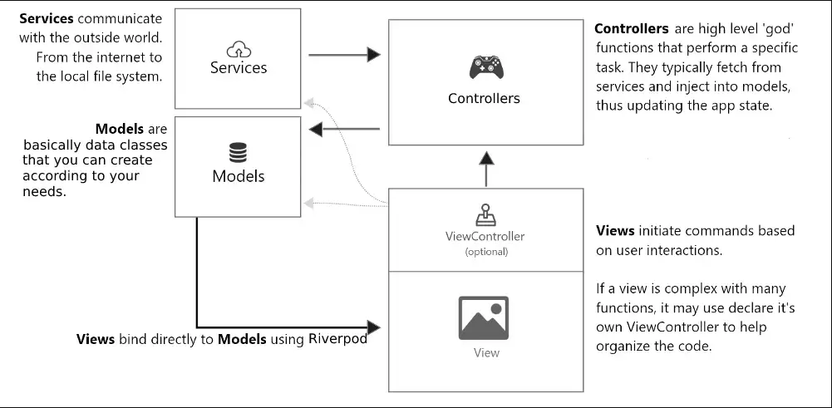
MVC+S Design Pattern

Slide 7
ADMIN
Admin can login and will be verified by database and after verification he will be allowed to used functionalities
Admin can register Doctor
Admin can delete Doctor
Admin can list all Doctors to check there details

Slide 8
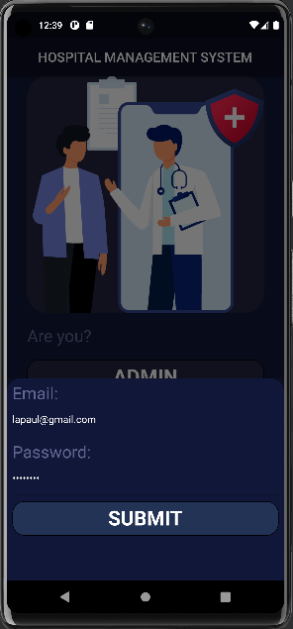
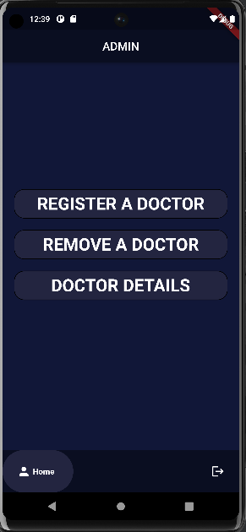
Admin's functionalities

Slide 9
PATIENT
Patient can register himself by providing required details
He can login which will be verified from database and after verification he will allow to use further functionalities
He can book appointments according to doctor availability
He can cancel appointments if needed.
He can see his/her all appointment's detail
He can check his/her BMI by filling al required fields.

Slide 10
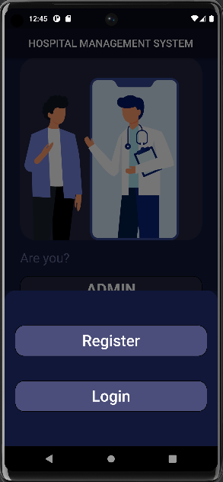
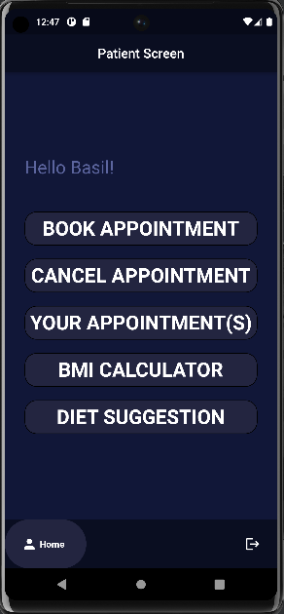
Patient's functionalities

Slide 11
DOCTORS
Doctor can register himself through Admin by giving required details
He can login which will be verified from database and after verification he will allow to use more functionalities
He can check all hi schedule appointments.
He can update his record if needed.

Slide 12
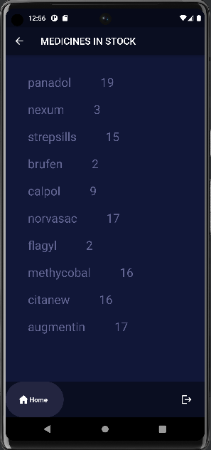
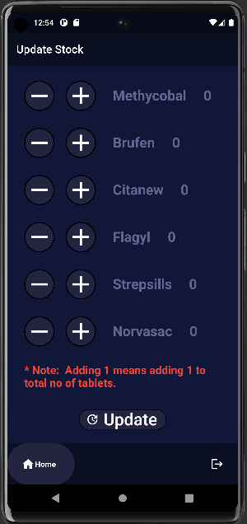
pharmacist's functionalities

Slide 13
PHARMACIST
Pharmacist can login which will be verified and after verification he will be allow to use further functionalities.
Pharmacist can update stock which will be then updated database for ease of user or patient buying medicine.

Slide 14
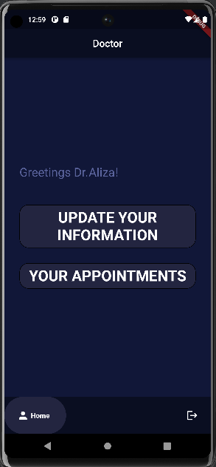
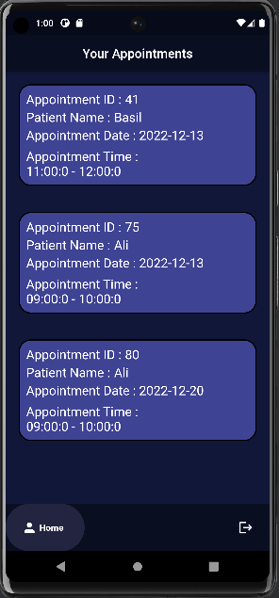
DOCTOR's functionalities

Slide 15
RANDOM USER
This user is one that is not registered or logged in.
These user can only avail pharmacy facility.
The user can check which medicines are available in stock and can book them.
After booking the app will generate token number which will be stored in database and their ordered will be prepared.
And by taking screenshot of that number the user can buy those medicine by showing token number and pay for it avoiding counter chaos and crowded public.

Slide 16
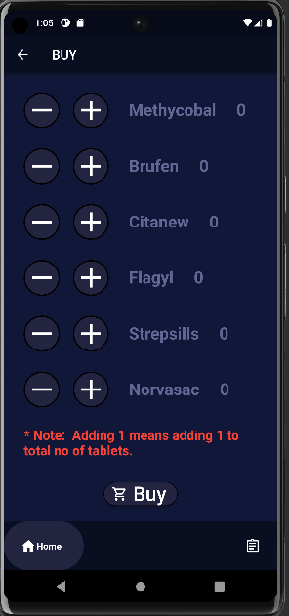
Random user's functionalities

Slide 17
CONCLUSION
We have developed a system for ease of patient and doctor for checking appointments and schedule them. Random users can also avail facility by avoiding counter chaos and with ease buy medicine. We have tried to build a platform where employees have all their details one click away at one single place.
Furthermore future advancement can be made by adding checkout and delivery option so user even don have to go to pharmacy and can have that at home.

Slide 18
THANK YOU

